Slide 1
Doubly Linked List Implementation in C
Data Structures Programming

Slide 2
What is Doubly Linked List?
Linear data structure with bidirectional links
Each node contains:
  Data
  Pointer to previous node
  Pointer to next node
C Benefits:
  Direct memory control
  Efficient pointer operations
  Foundation for complex structures
Visual:
NULL ⇄ [prev|data|next] ⇄ [prev|data|next] ⇄ [prev|data|next] ⇄ NULL

Slide 3
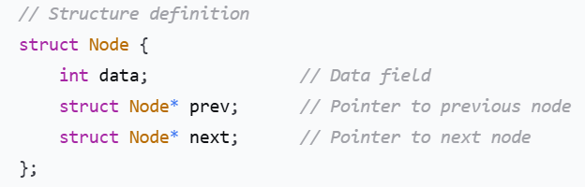

Node Structure in C

Slide 4
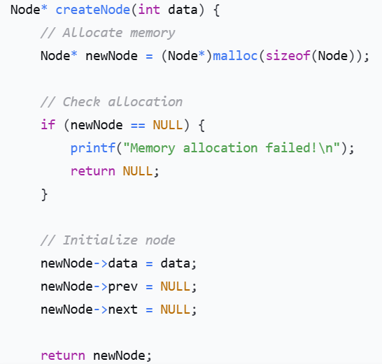
Creating a New Node

Slide 5
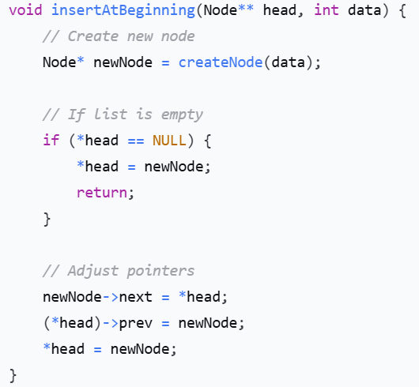
Insertion at Beginning

Slide 6
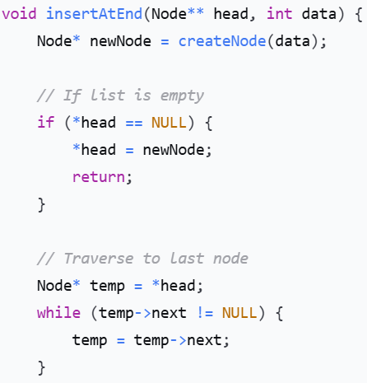
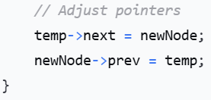
Insertion at End

Slide 7
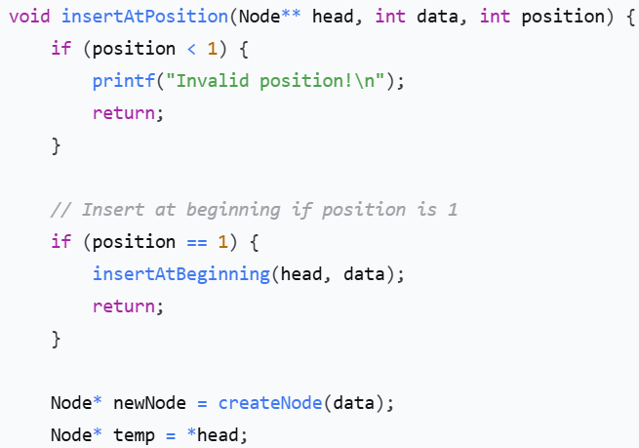
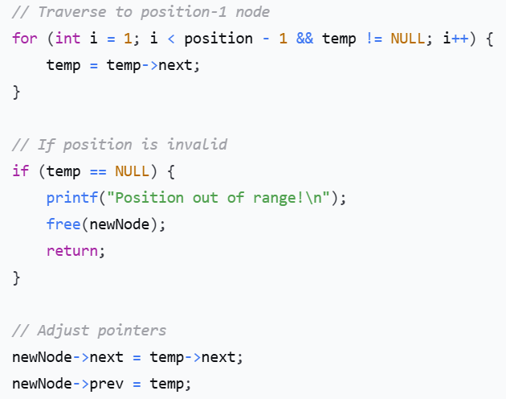
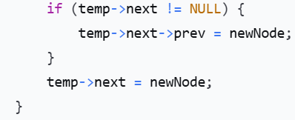
Insertion at Specific Position

Slide 8
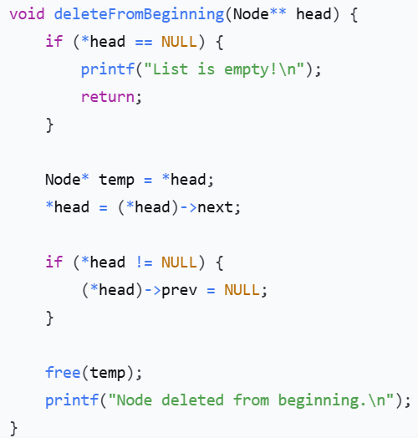
Deletion from Beginning

Slide 9
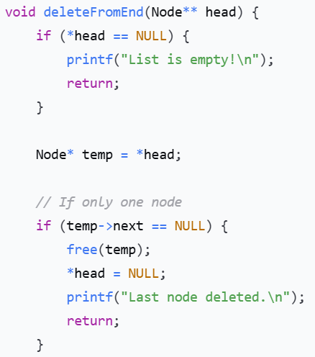
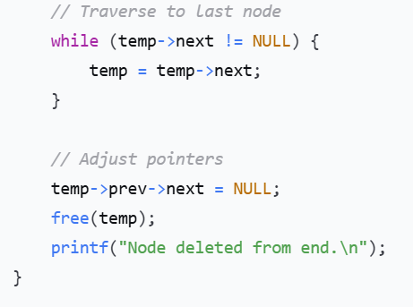
Deletion from End

Slide 10
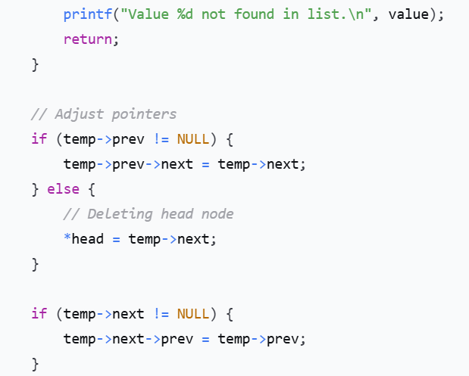
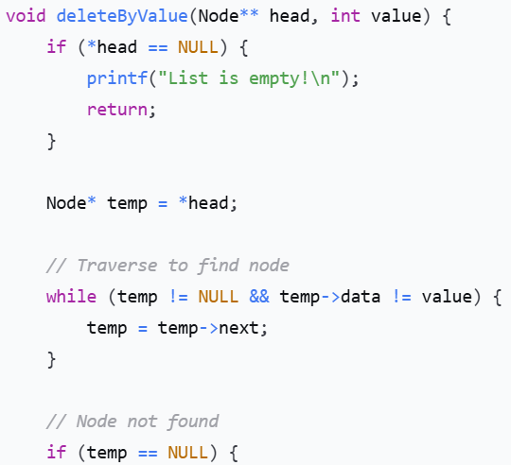
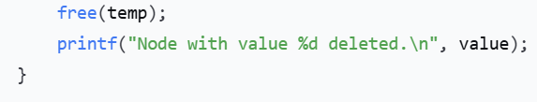
Deletion by Value

Slide 11
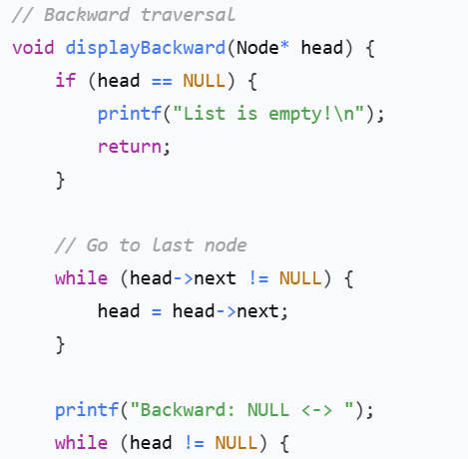
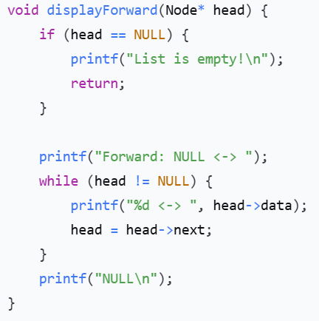
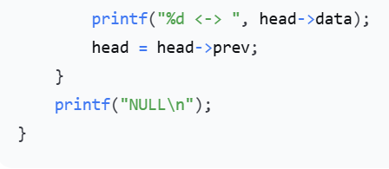
Traversal Functions

Slide 12
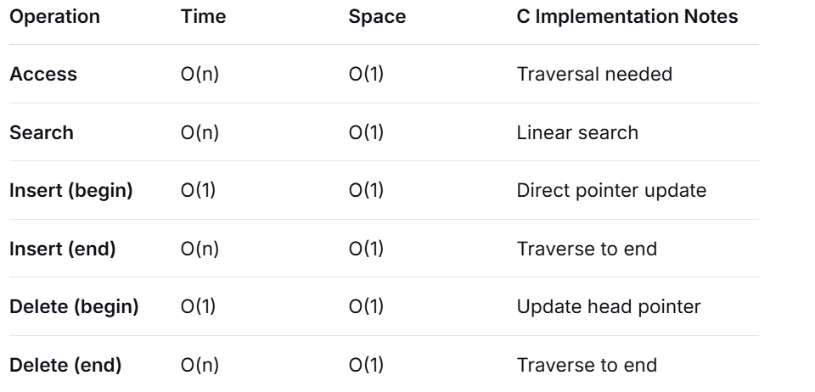
Complexity Analysis

Slide 13
Thank you

